Slide 1

SHRAA
SMART HOSPITAL ROOM ALLOTMENT APPLICATION USING IOT, CLOUD & DATA ANALYSIS
Guided by: Dr. Shajulin benedict Presented BY: HARSH SINGH
2015BCS0012

Slide 2
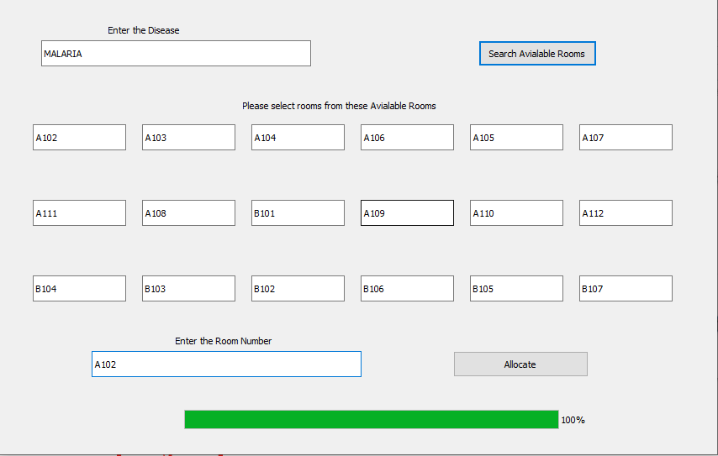
Graphical user Interface of Application

Slide 3
Table of contents
Introduction
Abstract
Literature survey
Preliminary Work
Existing model in market
DATASET
Architecture model
Result and discussion
References

Slide 4

introduction
Hospitals play a vital role in the health and well-being of people.
In recent times there are more patients visiting the hospitals owing to various reasons.
In a country like Indian where the hospital to patient ratio is very high it is essential to focus towards improving internal processes in order to attain maximum efficiency levels.

Slide 5
introduction
Although most patients are essentially well enough to be able to resist or to adapt to unfavourable ambient conditions, this may not be so with an ill patient or one who is having or has had a serious operation.
These climatic conditions of these operating room are needed to be discussed.
It is difficult or impossible to achieve climatic conditions in the operating room that are acceptable to all.
The needs of the patient are of special importance and are largely neglected.

Slide 6

abstract
The main objective is to analyse various diseases that are generally reported in the hospital and collect the data about those favourable and unfavourable conditions for those diseases. Then we will finally build a complete smart application which will automatically allocate the rooms to the patients INSIDE THE HOSPITAL according to their conditions.

Slide 7
Existing model in market
THIS product we have developed is unique since it is using different parameter values to automate the hospital room allocation process. This kind of product does not exist in the market.

Slide 8
Literature survey
Paper name | Date | Conclusion
Implementation of Cloud Computing Technology for the Improvement of Entire Healthcare Services in India 2013 International Conference on Advances in Technology and Engineering (ICATE) IEEE | 06 June 2013 | In this paper they have discussed about the way of monitoring of Doctors and Hospitals by their projected scheme and thus special care will be taken to provide cheap and effective service to every resident of our country without caring about the social status, economic condition or influence of the person. This will going to put end to the peoples doubt in government hospitals. Also it will going to stop the monopoly of private hospitals. Thus a unique health care system will be formed. So we can conclude that by using the technology inside the hospital the practicality between the rich and poor can be minimised.

Slide 9
Paper name | Date | Conclusion
Understanding social and behavioural drivers and impacts of air quality sensor use Science of The Total Environment Volume 621, Pages 886-894, Elsevier | 15 April 2018 | In this paper they have discussed about how the air quality sensor can be used in the welfare of humanity. They have talked about sensors and sensor data. They have also talked about the assessing methods for communicating sensor data.

Slide 10

Paper name | Date | Conclusion
Smart Air Quality Monitoring System with LoRaWAN (Long Range Wide Area Network) The 2018 IEEE International Conference on Internet of Things and Intelligence System (IoTaIS) IEEE | 2018 | This paper presents a scalable smart air quality monitoring system with low-cost sensors and long-range communication protocol. The sensors collect four parameters, temperature, humidity, dust and carbon dioxide in the air. The proposed end-to-end system has been implemented and deployed in Yangon, the business capital of Myanmar, as a case study since Jun 2018. The system allows the users to log in to an online dashboard to monitor the real-time status In addition, based the collected air quality parameters for the past two months, a machine learning model has been trained to make predictions of parameters such that proactive actions can be taken to alleviate the impacts from air pollution

Slide 11
Paper name | Date | Conclusion
Real-Time Air Pollution Monitoring Systems Using Wireless Sensor Networks Connected in a Cloud-Computing, Wrapped up Web Services FTC 2018: Proceedings of the Future Technologies Conference (FTC) 2018 page 171-184 | 2018 | As part of preventive measures, this paper presents the design and implementation of a secure and low-cost real-time air pollution monitoring system. a three-layer architecture system was implemented. The first layer contains sensors connected to an Arduino platform towards the data processing node (Raspberry’s Pi), which through a wireless network sends messages The application layer consists of a server published in the cloud infrastructure having an MQTT Broker service, which performs the gateway functions of the messages sent from the sensor layer. The client layer can be accessed from a Web browser, a PC or smartphone.

Slide 12
Paper name | Date | Conclusion
Dynamic scheduler - a pervasive healthcare system in smart hospitals using RFID 2008 International Conference on Computing, Communication and Networking IEEE | 2008 | This paper presents a solution to this multi objective dynamic scheduling problem using evolutionary algorithms. The aim is to minimize the patient waiting (idle) time, and the appointment slots for doctors should be rendered continuously. This can be done by optimally allocating doctors and appointment slots to the patients instead of following first come first serve technique. Thus it can be concluded that dynamic scheduling algorithm efficiently handles the resource allocation problem (RAP) by using evolutionary approach.

Slide 13
Paper name | Date | Conclusion
Random forests resource allocation for 5G systems: Performance and robustness study 2018 IEEE Wireless Communications and Networking Conference Workshops (WCNCW) | 31 May 2018 | The main hypothesis behind this study is that both the coordinated resource allocation complexity and the signalling overhead can be significantly reduced by exploiting explicit knowledge about a terminal's position to make resource allocation predictions. More specifically, They have presented a design of a learning-based resource allocation scheme for 5G systems that uses Random Forests as multi-class classifier. In this paper it is shown that even for quite large variations the learning-based approach can still exhibit good performance. This hypothesis of resource allocation can be used in our project for rooms allocation.

Slide 14
Paper name | Date | Conclusion
Real-Time Measurement of Temperature Sensitive Electrical Parameters in SiC Power MOSFETs Antionio Griffo, Jiabin Wang, Transactions on Industrial Electronics, Volume 65, Issue 3, March 2018, IEEE | March 2018 | This paper examines a number of techniques for junction temperature estimation of silicon carbide (SiC) MOSFETs devices (metal oxide semiconductor field effect transistor) based on the measurement of temperature sensitive electrical parameters for use in online condition monitoring. Linearity, sensitivity to temperature, and circuit design for practical implementation are discussed in detail. The proposed method can provide a valuable tool for continuous health monitoring in emerging applications of SiC devices to high-reliability applications

Slide 15
Paper name | Date | Conclusion
A raspberry Pi controlled cloud based air and sound pollution monitoring system with temperature and humidity sensing Arnab Kumar Saha, Sachet Sircar, 2018 IEEE 8th Annual Computing and Communication Workshop and Conference (CCWC) IEEE | Jan 2018 | In this project, an IOT-based method to monitor the Air Quality Index and the Noise Intensity of a region, have been proposed. The recommended technology comprises of four modules namely, the Air Quality Index Monitoring Module, the Sound Intensity Detection Module, the Cloud-based Monitoring Module and the Anomaly Notification Module. the Air Quality Index is measured considering the presence of the five criteria air pollutants. Then the sound intensity is detected using respective sensor. After that, the Cloud-based Monitoring Module ensures the process of acquiring the data with the help of Wi-fi-module present in Raspberry Pi which fulfils the objective of analysis of information on a periodical basis. Finally, the Anomaly Notification Module alerts the user in case of an undesired condition.

Slide 16
PREVIOUS WORK
we Had made “ air quality monitoring system ”
that dataset that we were using was a atmospheric dataset which contains few entries which were used to classify the air quality into the different air quality levels.
For the classification of the air quality, we developed a new architecture and by applying cloud computing we made an application which can tell whether you are in safe environment or not.

Slide 17
About the dataset
Special thanks to Saumya Singhal (MBBS Final year, Government Medical College, Raigarh) for dedicating her time and energy into this dataset formation process, without the domain expert its too difficult to trust the dataset.
Hospital disease dataset contains 264 rows and 5 columns.
Room description dataset contains 85 rows and 5 columns.
Hospital consist of 7 floors and 12 rooms in each floor.

Slide 18
Attributes in Hospital Disease Dataset
Disease : This attribute tells the name of the disease.
Temperature : This attribute tells what is the suitable value of temperature for the patients suffering from that disease. Patients can stay in room which have the temperature value less than the given temperature in the dataset.
Humidity : This attribute tells what is the suitable value of humidity for the patients suffering from that disease. Patients can stay in room which have the humidity value less than the given humidity in the dataset.
Air Quality : This attribute tells what is the suitable value of Air Quality for the patients suffering from that disease. Patients can stay in room which have the Air Quality value less than the given Air Quality in the dataset.
Description : This attribute tells the type of disease and the description related to it.

Slide 19
Attributes in Room description Dataset
roomNo : This attribute is room number identifier which can be used to identify the specific room in whole hospital.
Temperature : This attribute tells what is the temperature inside that room.
Humidity : This attribute tells what is the humidity inside that room.
Air Quality : This attribute tells what is the Air Quality (dust) inside that room.
Status: This attribute tells whether room is already occupied or not. Zero is denoted as empty room and One means room is already occupied by patient.

Slide 20
Tools and Libraries
The Jupyter Notebook
Qt Designer
Arduino IDE
MS Excel
Pandas
NumPy
SciPy
SoftwareSerial
Tools
Libraries

Slide 21
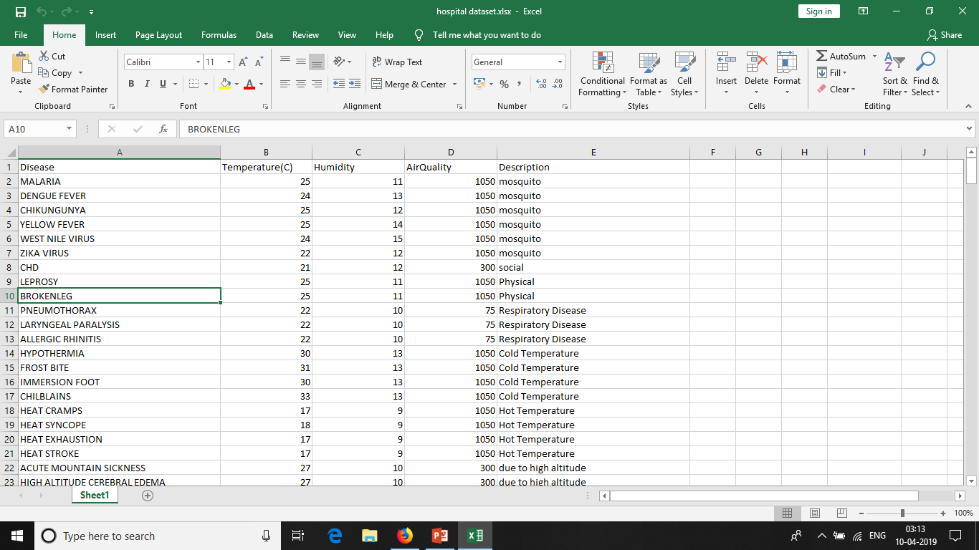

Slide 22
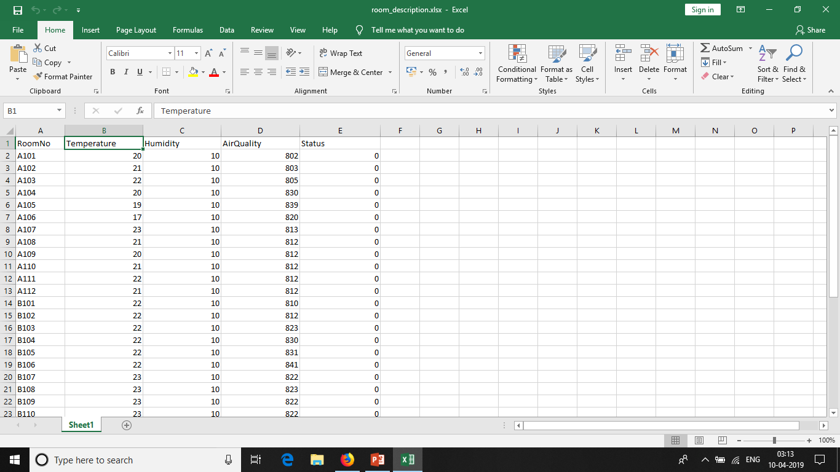

Slide 23
ONLINE RESOURCES
DOCTOR
CLOUD
DEVICE 2
SMOKE SENSOR
Data Collection
Readings
DATASET
DEVICE 1
Temperature
SENSOR
APPLICATION
MANAGER
Humidity SENSOR
Data Pre-processing
RESULT
(Room Allocation)
AirQuality SENSOR
DATA ANALYSIS

Slide 24
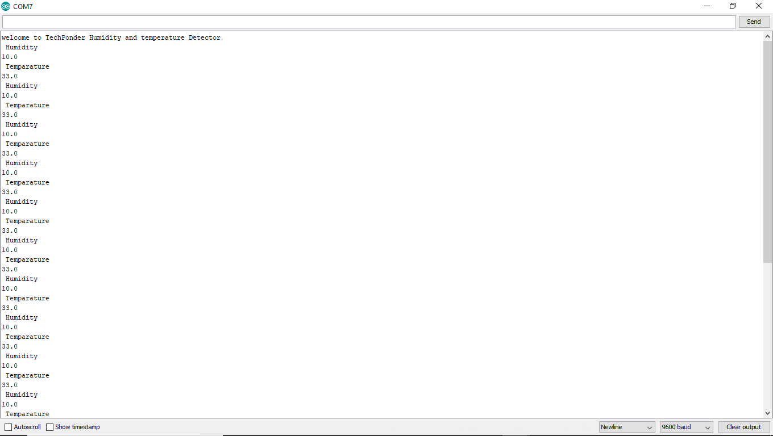
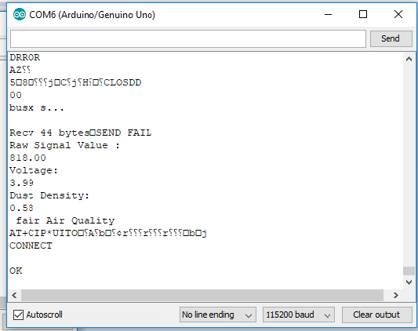
Dust sensor Readings
Temperature and Humidity sensors Readings

Slide 25
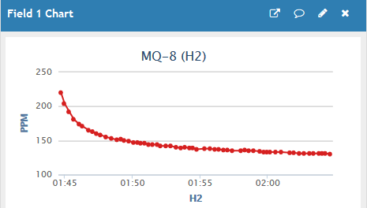
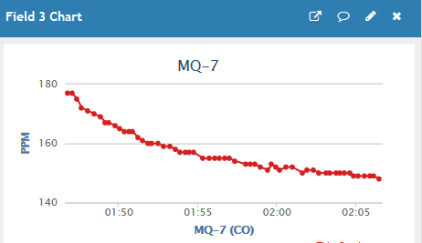
MQ-8 sensor Readings
MQ -7 sensor Readings

Slide 26
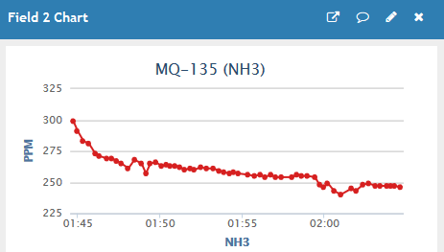
MQ-135 sensor Readings

Slide 27
Graphical user Interface of Application

Slide 28
Approach
We will analyze the various diseases which the hospital generally witness.
Then we will make the dataset which will be HEALTHCARE DATASET hence few misleading entries are present in the dataset, hence we are going to pre processed the dataset i.e. we are going to do DATA CLEANING..
After that we will build a DEVICE MODEL with the help of sensors which will sense the environmental conditions of every room present in the hospital.
After getting these reading from the sensor device we will make an application and with the help of dataset we have made we will automate the hospital room allocation process.
pyuic4.bat -x ***.ui -o ***.py

Slide 29
references
[1] Implementation of Cloud computing technology for the improvement of entire healthcare services in India, Gaurav Bhatia ; Ajay Lala ; Ashish Chaurasia ; Ramandeep Rajpal, 2013 International Conference on Advances in Technology and Engineering (ICATE), IEEE
[2] Understanding social and behavioral drivers and impacts of air quality sensor use, Bryan j Hubbell, Amanda kaufman, Science of The Total Environment, Volume 621, Pages 886-894, Elsevier
[3] Real-Time Air Pollution Monitoring Systems Using Wireless Sensor Networks Connected in a Cloud-Computing, Wrapped up Web Services, Byron Guanochanga, Rolando Cachipuendo, FTC 2018, Proceedings of the Future Technologies Conference (FTC) 2018, page 171-184, Springer
[4] Real-Time Measurement of Temperature Sensitive Electrical Parameters in SiC Power MOSFETs, antionio griffo, jiabin wang, IEEE Transactions on Industrial Electronics, volume 65, issue 3, march 2018
[5] Ultrafast Response Polyelectrolyte Humidity Sensor for Respiration Monitoring, jianxun dai, hongran zhao, Applications of Polymer, Composite, and Coating Materials, ACS, JAN 2019
[6] IoT and Wireless sensing network Based Health and Home Management, Subhas Mukhopadhyay, Second Edition, IEEE, 2017.

Slide 30
references
[7] Towards a Real-Time Air Pollution Monitoring Systems Implemented using Wireless Sensor Networks: Preliminary Results, Byron guanochanga, Rolando cachipuendo, 2018 IEEE Colombian Conference on Communications and Computing (COLCOM), IEEE.
[8] Random forests resource allocation for 5G systems: Performance and robustness study, 2018 IEEE Wireless Communications and Networking Conference Workshops (WCNCW), 31 May 2018
[9] Data Analytics on Real-Time Air Pollution Monitoring System Derived from a Wireless Sensor Network, Alyssa cadena, jenny torres, International Conference on Information Technology & Systems, ICITS 2019, page 57-67, Springer
[10 ] Smart Air Quality Monitoring System with LoRaWAN (Long Range Wide Area Network), The 2018 IEEE International Conference on Internet of Things and Intelligence System (IoTaIS), IEEE
[11] Dynamic scheduler - a pervasive healthcare system in smart hospitals using RFID, 2008 International Conference on Computing, Communication and Networking, IEEE
[12] A raspberry Pi controlled cloud based air and sound pollution monitoring system with temperature and humidity sensing, Arnab Kumar Saha, Sachet Sircar, 2018 IEEE 8th Annual Computing and Communication Workshop and Conference (CCWC) ,IEEE

